Slide 1
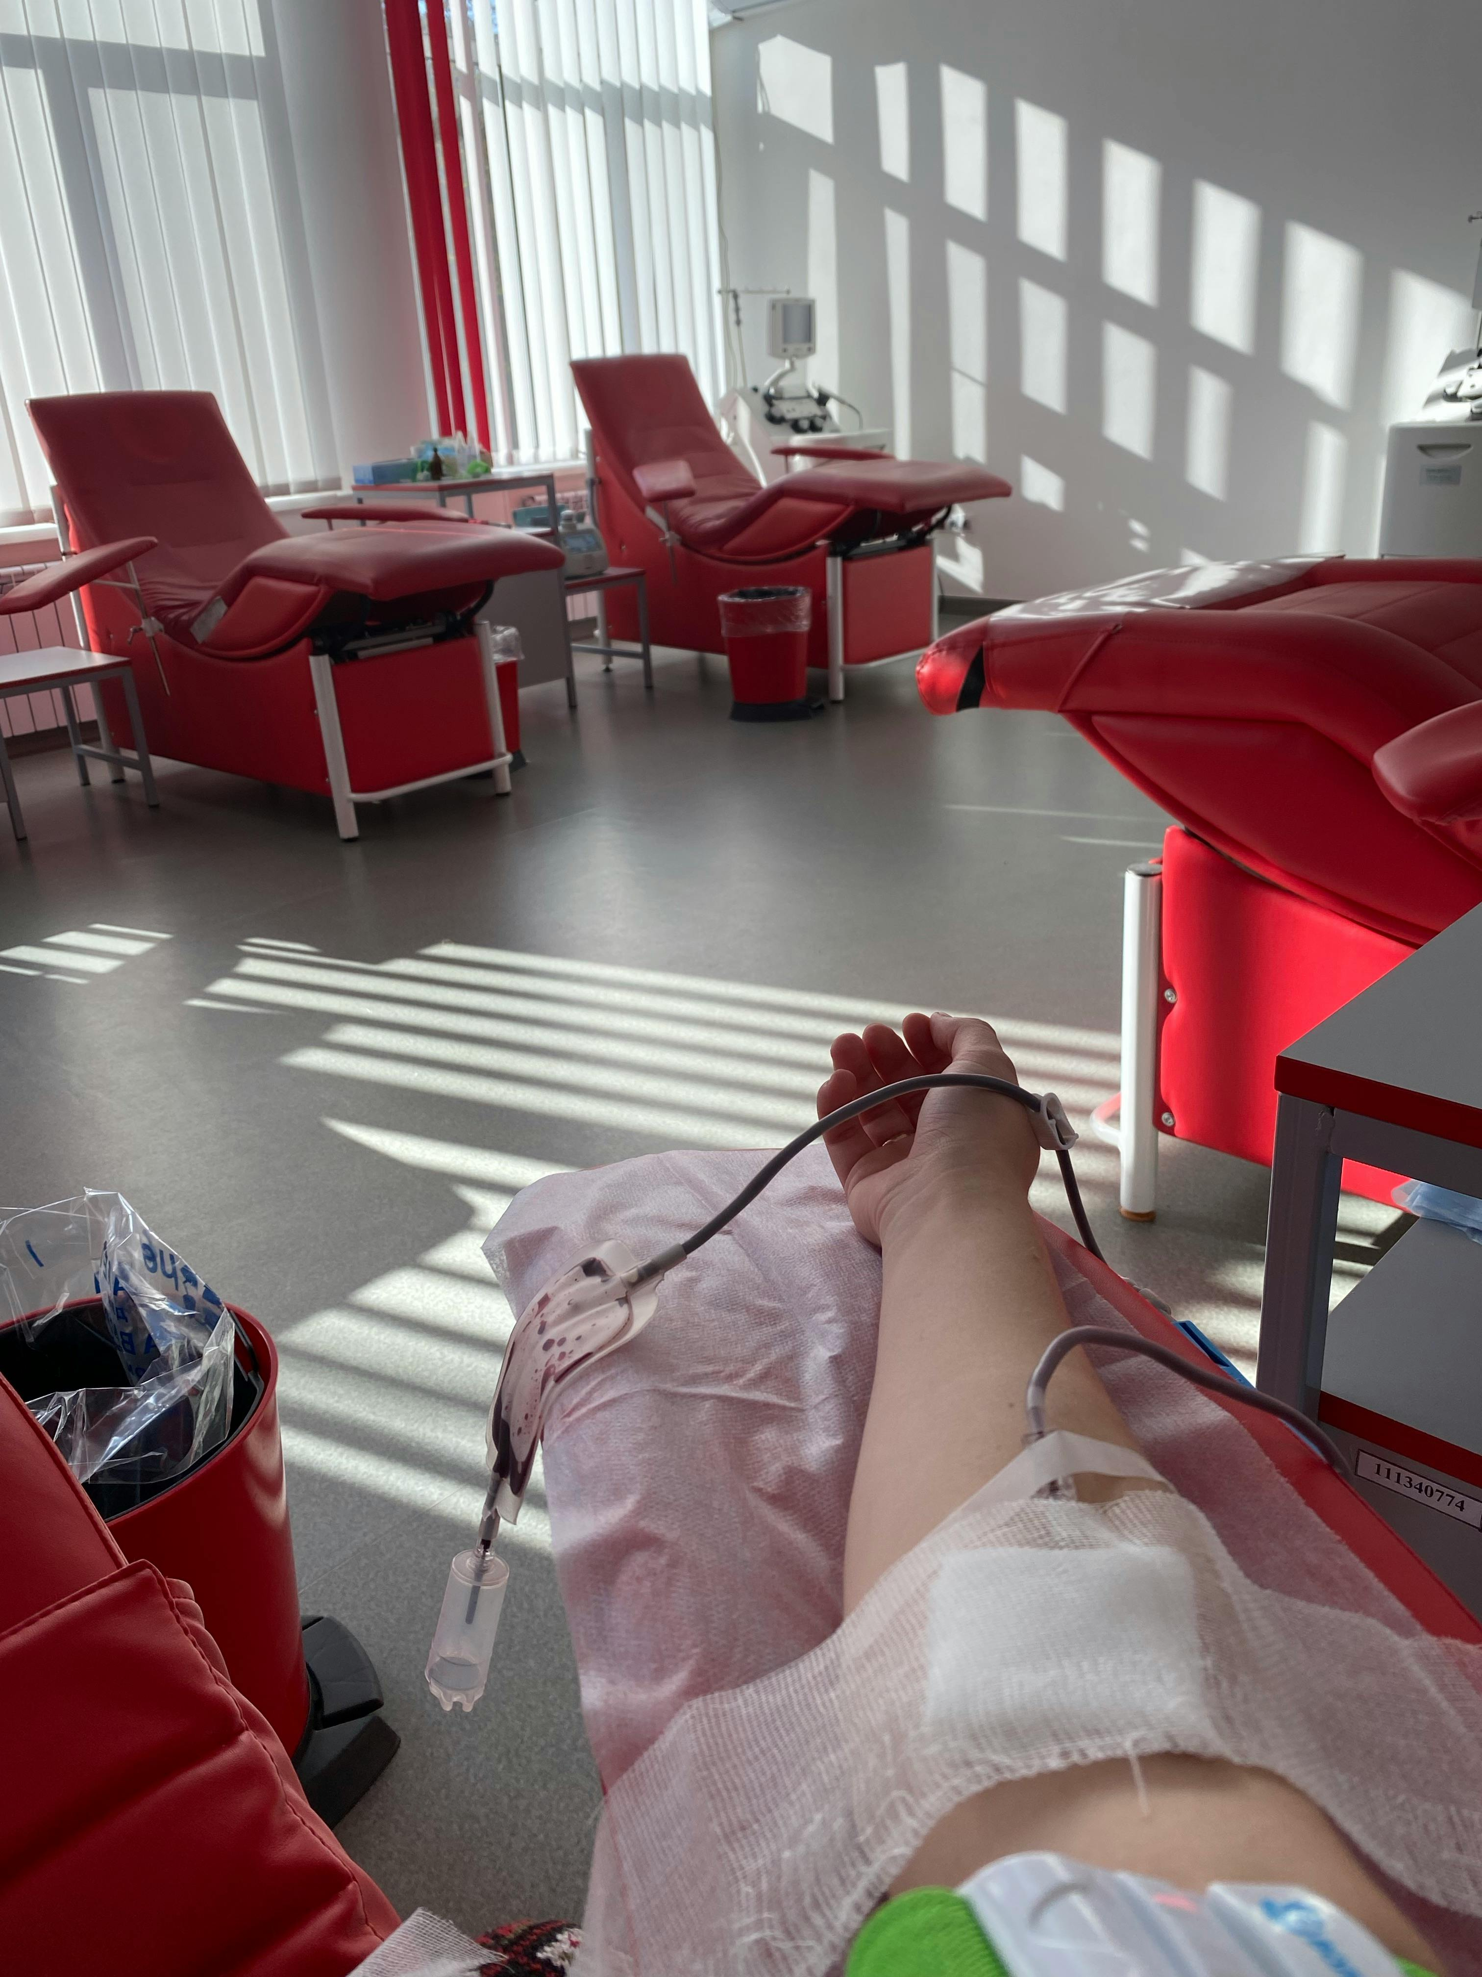
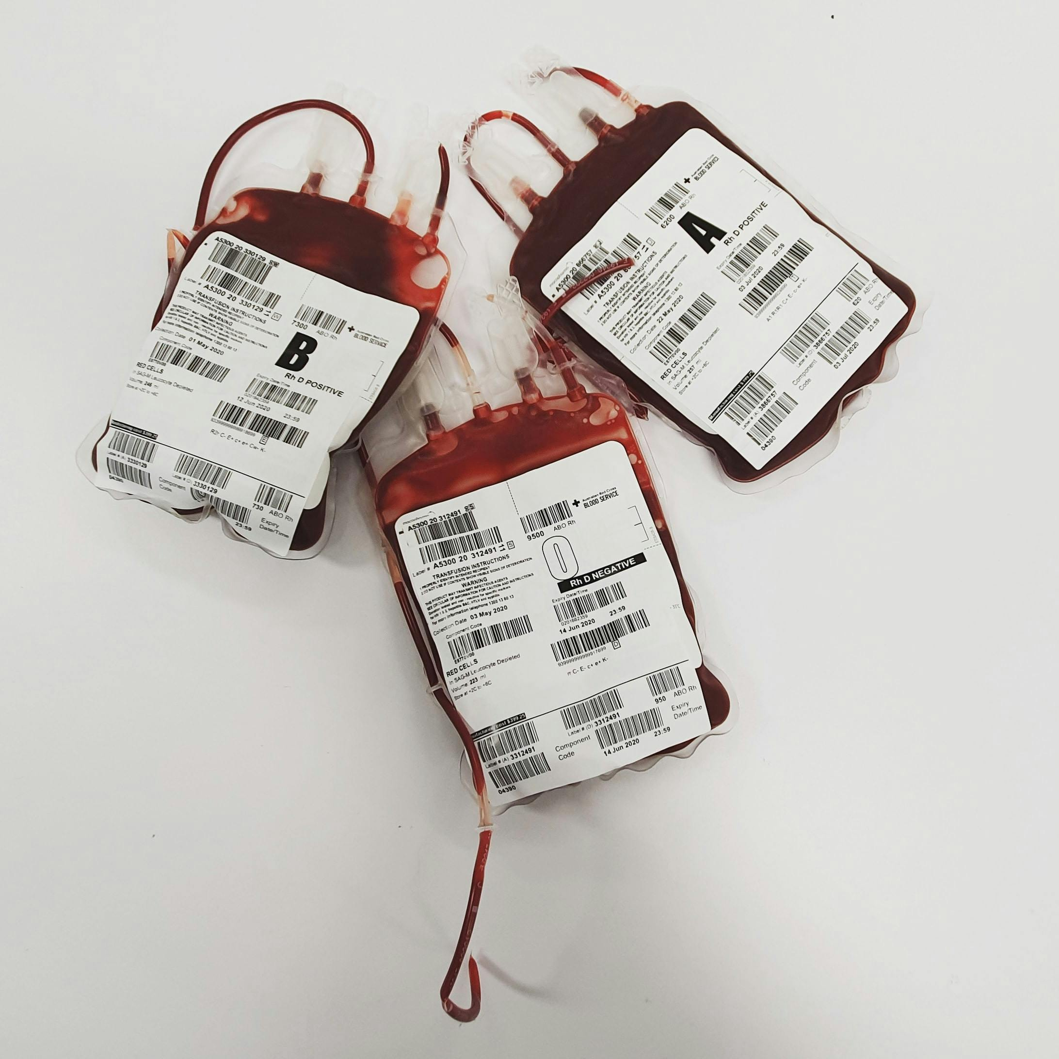
LIFELINK BLOOD DONATION PLATFORM
FACULTY: FACULTY OF SCIENCE AND TECHNOLOGY DEPARTMENT: COMPUTER SCIENCE NAME: CYNTHIA BONARERI ORINA REG NO: EB1/61379/22
Revolutionizing blood donation management in Kenya through AI-powered digital solutions for efficient and transparent blood distribution.

Slide 2
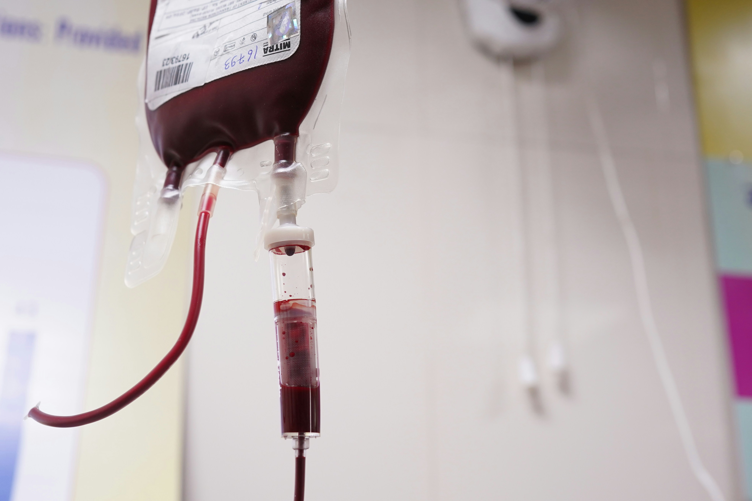
BACKGROUND TO THE STUDY
LifeLink is a smart, digitized blood donation and management platform.
It aims to modernize Kenya’s blood donation ecosystem by improving donor recruitment, management, and hospital coordination.
The system provides real-time monitoring and communication between donors, hospitals, and blood banks.

Slide 3
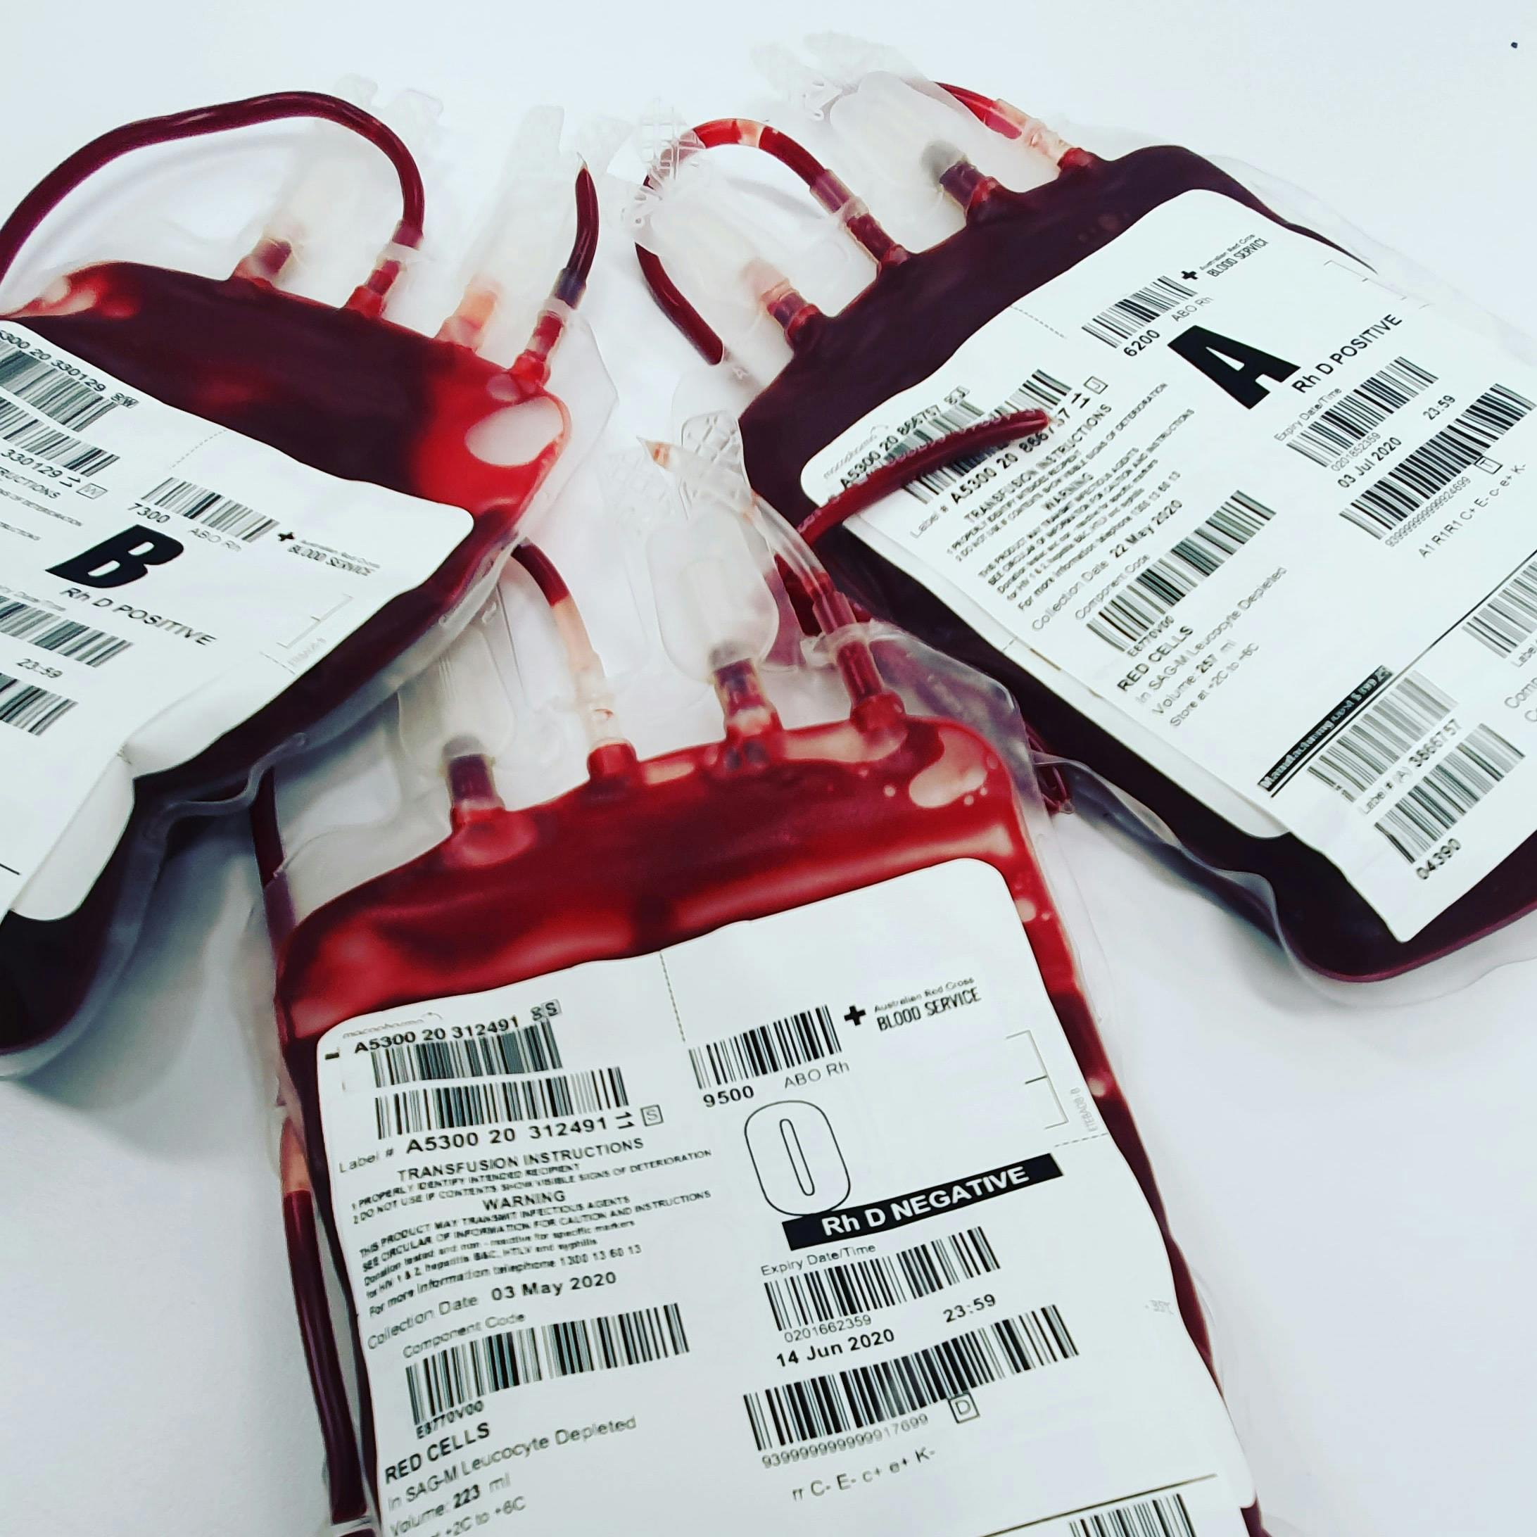
PROBLEM STATEMENT
Kenya faces the following major issues:
Blood shortages due to:
Poor communication in cases of emergencies
Poor Donor Retention due to not engaging the donors and limited feedback mechanisms.
Manual donor records led to delays, duplication, and data loss.
Lack of real-time donor information and blood stock visibility across hospitals.
Fragmented blood donation systems with lack of centralization.
There are no predictive systems for identifying blood shortages, seasonal needs and regional variations in supply.

Slide 4
OBJECTIVES
General: To design and implement an intelligent digital platform that improves blood donation efficiency and availability in Kenya.
Specific:
To implement secure multi-role authentication and access control.
To implement donor profile completion, eligibility updates, and donation history tracking.
To implement blood request lifecycle management and fulfillment workflows.
To implement analytics and forecasting dashboards for operations support.
To implement notifications and audit logs for traceability.

Slide 5

Key Features of LifeLink
Donor Management System: Registration, eligibility tracking, donation history.
Hospital Dashboard: Real-time stock levels, request management.
Shortage Prediction Module: Forecasts blood supply gaps.
Notifications & Awareness: app alerts, donation reminders.
Secure Database: Centralized, scalable data management.

Slide 6
METHODOLOGY
Approach: Mixed methods; combines user feedback with technical analysis(qualitative + quantitative).
Research Design: Systems Development Research Design covering analysis, design, implementation, testing, evaluation.
Development Model: Agile (Scrum); iterative sprints for continuous improvement.
Technologies: Flutter (mobile), Spring Boot backend, HTML frontend, PostgreSQL, Java-based predictive analytics, cloud deployment (Render).
Security: JWT, Bcrypt password, role-based access, compliance with Data Protection Act.
Ethics: Anonymized data, adherence to national guidelines.

Slide 7
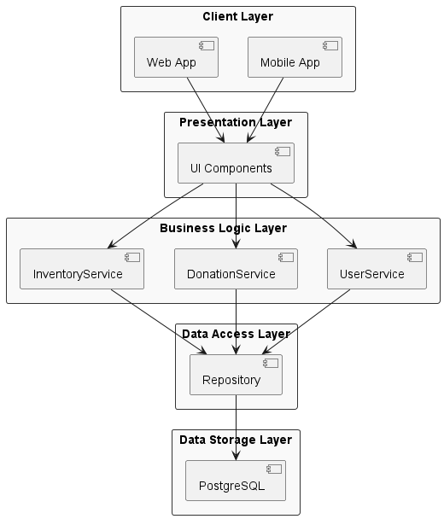

Slide 8
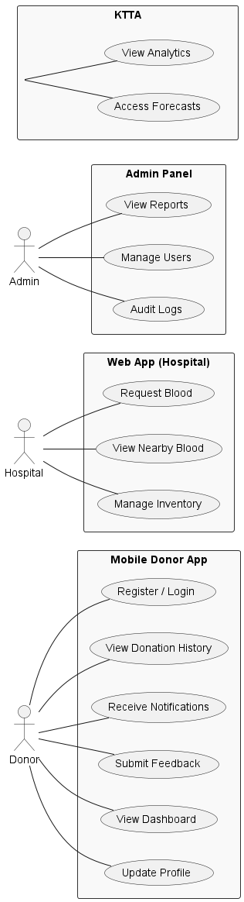
SYSTEM DESIGN

Slide 9


THANK YOU
&
Q&A
- Ready for questions
Notes:
Thank you for your attention! I are ready to answer any questions you may have about our project.

